Slide 1
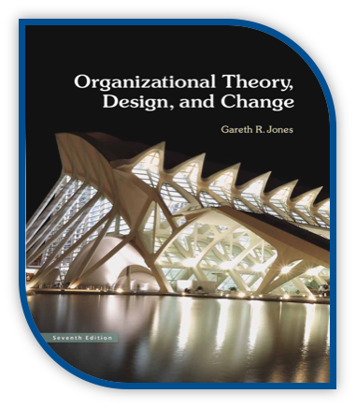
MSCI 311
Organizational Design and Technology
Instructor: Ayman Alzayat, aalzayat@uwaterloo.ca
TA: Varsha Suryanarayana, vsuryana@uwaterloo.ca

Slide 2
Decision Making
Rational Approach
Individual Decision Making
Bounded Rationality Approach
Intuitive Approach
Decision Making
Management Sciences Approach
Organizational Decision Making
Carnegie Model
Garbage Can Model
(Chapter 8 in the Textbook)

Slide 3
Organizational Decision Making (groups)
Evaluation of Group Decision Making
Advantages:
More knowledge
More communication on issues
Acceptance of the outcome (e.g. Eating habits)
Factors that reduce effectiveness
Slow and inefficiency (e.g. Democracy)
Compromised solution (e.g. assigned budget for a new program)
One person may dominate.
Groupthink

Slide 4
Groupthink symptoms
1. Illusion of Invulnerability
Group becomes over-optimistic and is willing to take extraordinary risks
2. Construction of Rationale
Group collectively constructs rationalizations in order to discount warnings
3. Illusion of Morality
Group believes in its inherent morality and ignores ethical and moral consequences of their decisions
4. Stereotyping others
Group holds stereotyped views of the leaders of enemy groups

Slide 5
Groupthink symptoms
5. Internal pressure
Group pressures individuals who momentarily express doubts
6. Self- Censorship
Group members avoid deviating from what appears to be the group consensus
7. Illusion of Unanimity
Group believes that al members share the judgements expressed by those who speak in favour of the majority view. Assumption that if you’re silent then you must be agreeing.
8. Self-appointment as Mindguards
Members appoint themselves as mindguards to protect the leader and fellow members from adverse information that might threaten their shared understanding of the effectiveness of past decisions.

Slide 6
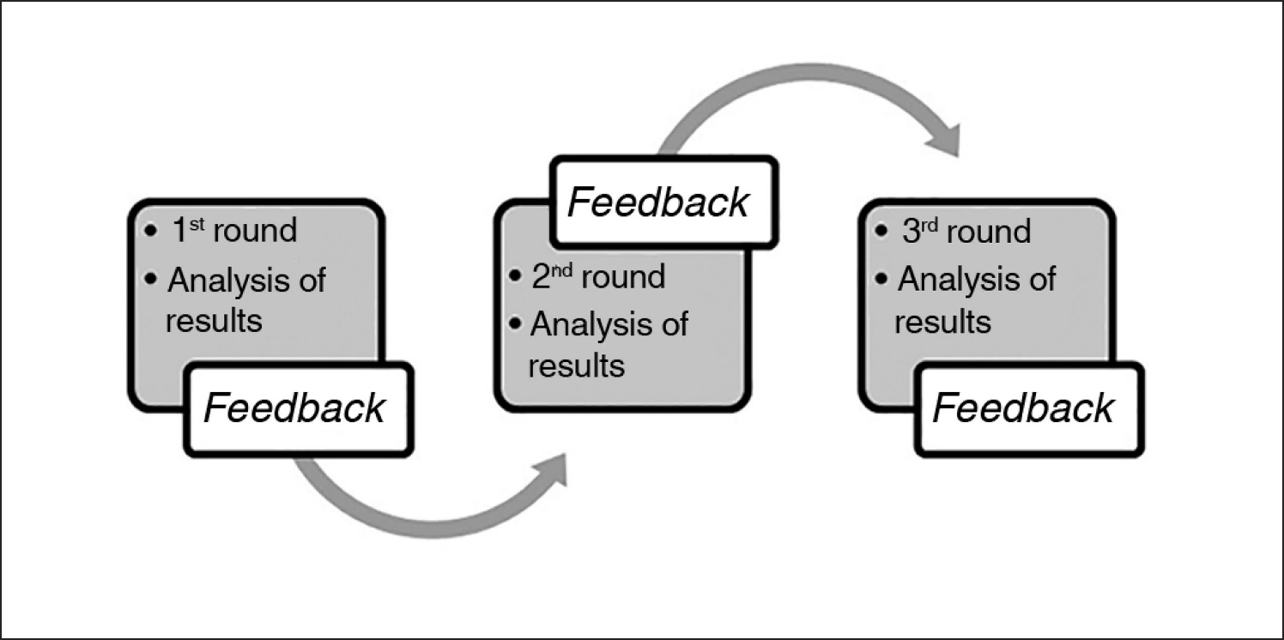
Organizational Decision Making (groups)
Possible improvement for group decision marking
Brain storming
Generate ideas without evaluation
Nominal group technique
Members express preferences or solution anonymously.
Delphi Technique:

Slide 7
Organizational Decision Making
1- The Management Sciences Approach
Like rational decision making for individuals
Operations research tools and algorithms
Linear programming
Queuing theory
Stochastic modelling
MSCI department at UW
Applications include scheduling of flights, management of call centers, identification of optimal inventory levels, scheduling of staff, designing optimal layouts, etc.
Management Sciences tools are useful when problems are analyzable, measurable and logically structured.
MS tools can not be used effectively to evaluate qualitative non measurable alternatives.

Slide 8
Organizational Decision Making
2- The Carnegie Model (Cyert, March, & Simon)
Coalitions
Bargaining
Decision making as result of compromise
Side payments
Money, personal treatment, authority, organization policy
Organizational slack

Slide 9
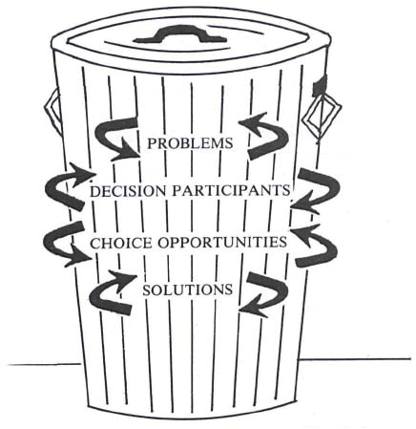
Organizational Decision Making
3- The Garbage Can Mode
According to this view:
“An organization is a collection of choices looking for problems, issues and feelings looking for decision situations in which they might be aired, solutions looking for issues to which they might be the answer, and decision makers looking for work”

Slide 10
Organizational Decision Making
3- The Garbage Can Model
a. Problematic preferences.
Preferences are not consistent or well-defined. “[Organization] discovers preferences through action more than it acts on the basis of preferences”
b. Unclear technology.
Processes are not well understood. Progress is somewhat accidental, often based on trial and error.
c. Fluid participation.
Participants (decision makers and audience) are always changing.

Slide 11
Organizational Decision Making
3- The Garbage Can Model:
a. Problems: “issues of lifestyle, family, frustrations of work, careers, group relations within the organization, distribution of status, jobs, money, ideology …”
b. Solutions: Somebody’s product. A product (solution) is created without necessarily identifying the need first
c. Participants: Participants come and go – time as a limitation
d. Choice opportunities: Occasions in which organization can make a decision. Examples: signing contracts, hiring, promotions, expenses, task allocation

Slide 12
Organizational Decision Making
3- The Garbage Can Model:
Consequences of the garbage can model:
1- solutions may be proposed even when problems do not exist, e.g. intro of PC in the 70s.
2- Choices are made without solving problems, e.g. creating new department.
3- Problems may persist without being solved
4- A few problems are solved

Slide 13
The Garbage Can Model | The Carnegie Model | Management Sciences Model
Problems are a result of organized anarchy. can produce reactive rather than proactive solutions, decisions are a result of chance | Problems are a results of social political interactions | problems are analyzable, measurable and logically structured.
The garbage can model does not assume a feedback of the decision. considers resources as practical and significant determinants of choices | Can not be used for standardized decision making, qualitative decision are articulated by a group of people | can not be used effectively to evaluate qualitative non measurable alternatives.
variety | variety | variety
uncertainty | uncertainty | uncertainty

Slide 14
Organizational Decision Making
Ethics in Decision Making
Why Unethical Behavior Emerges
Pursuit of self-interest
Socialization (e.g. unethical behavior starts within a community and carry on sometimes, socialization in the organization build ethical behavior)
Pressure to Perform (e.g. pressure on employees to reach a target)
Poor communication (e.g. an employee might not be aware of what constitute acceptable behavior)
Loose Controls (e.g. people are more likely to engage in unethical behavior when they are provided with ample opportunity to do so.

Slide 15
Organizational Decision Making
Ethics in Decision Making
Clear articulation of top management values
Structural arrangements (e.g. ambassador of ethical behavior)
Ethical Organization
Leading by action
Communication and encouraging questioning
Use of symbols and ceremonies

